Slide 1



WALKART
Customer Analytics
OPIM 5604 | Spring 2017 | Tuesday
Team 9
Aditya Rai, Gaurav Vijay, Namratha Kasineni,
Rahul Kumar Thatikonda, Ruiqi Xing

Slide 2
Index
Customer Analytics
Problem Statement
Data Mining- Our Approach
Data Dictionary and Data Exploration
Data Visualization
Linear Regression Model 1
Feature Engineering
Linear Regression Model 2
Regression Tree and Ensemble Techniques
Neural Network
Model Comparison and Validation
Case Reviews
Future Upgrades: Market Basket Analysis

Slide 3
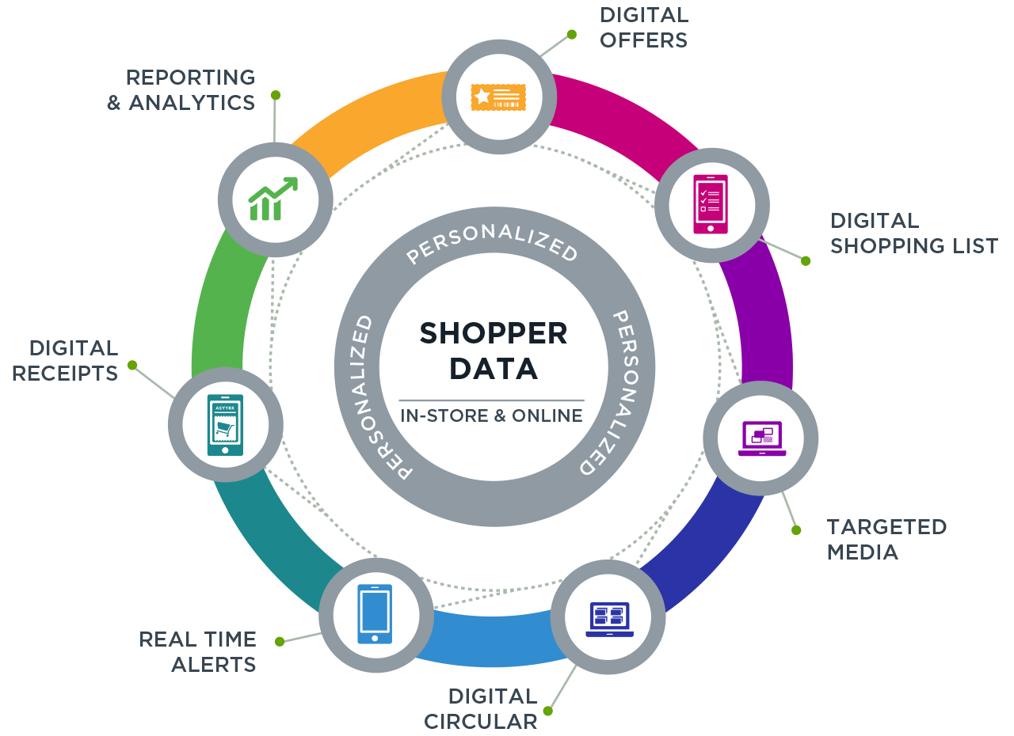
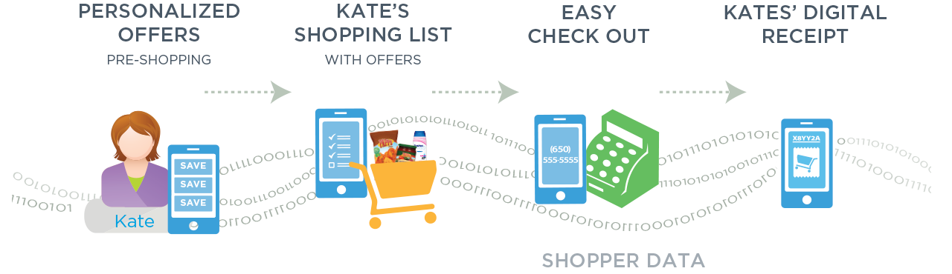

Customer Analytics

Slide 4






Problem Statement
A retail company “Walkart” wants to understand the customer purchase behavior (specifically, purchase amount) against various products of different categories and predict the purchase amount of customer against various products which will help them to create personalized offer for customers against different products.
JOB
GENDER
AGE
CITY
SHOPPING DATA
TENURE
MARITAL STATUS

Slide 5
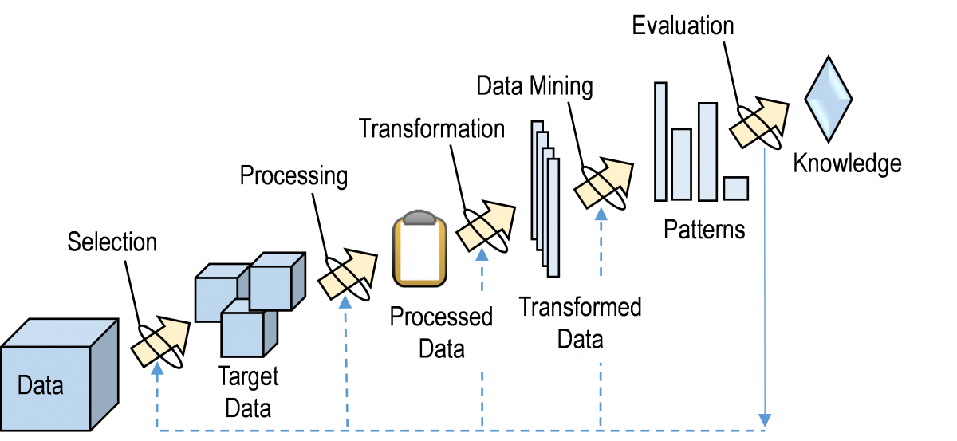
Data Mining – Our Approach
Identified the problem statement which is to create a predictive model to provide personalized discount offers to customers based on their shopping behavior and demographics.
Dataset source -analyticsvidhya.com
No missing values or outliers
Changed the datatype and modeling type of some fields
Used feature engineering technique to introduce new features based on functional knowledge of retail industry
Identified patterns and insights through visualizations
Created predictive models
Evaluated and compared models
Identified best model for implementation
Ran market basket analysis

Slide 6
Data Dictionary and Data Exploration
Coloumn Name | Data type & Modeling type (Old ► New) | No. of Categories
User_ID | Numeric; Continuous ► Character; Nominal | 5891
Product_ID | Character; Nominal | 3631
Gender | Character; Nominal | 2 (‘M’ or ‘F’)
Age | Character; Nominal ► Character; Ordinal | 7 (‘0-17’, ‘18-25’, ‘26-35’, ‘36-45’, ‘46-50’, ‘51-55’ and ‘55+’)
Occupation | Numeric; Continuous► Numeric; Nominal | 21 (0 to 20)
City_category | Character; Nominal ► Character; Ordinal | 3 (‘A’, ‘B’ and ‘C’)
Stay_in_current_city | Character; Nominal ► Character; Ordinal | 5 (‘0’, ‘1’, ‘2’, ‘3’, ‘4+’)
Marital_status | Numeric; Continuous ► Numeric; Nominal | 2 (‘0’ or ‘1’)
Product_category_1 | Numeric; Continuous ► Numeric; Nominal | 20 (1 to 20)
Purchase | Numeric; Continuous

Slide 7
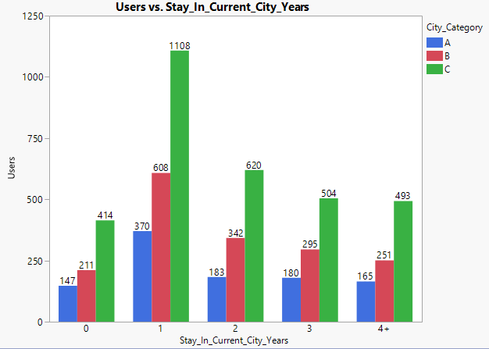
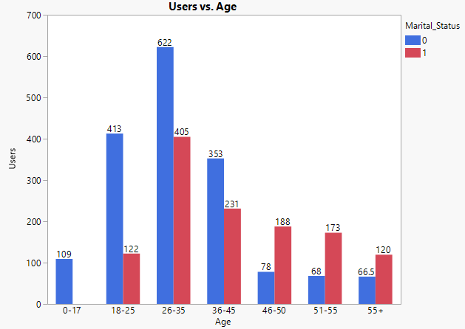
Data Visualization
No. of users per stay duration and city category. No. of users per age and marital status category.

Slide 8
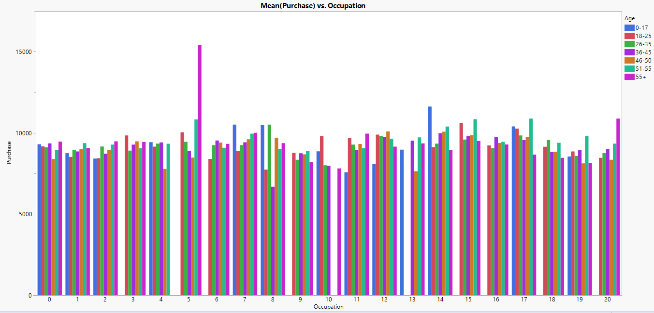
Data Visualization.….
Mean purchase price by occupation and age bins.

Slide 9
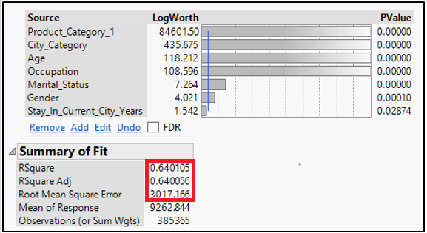
Linear Regression Model 1
Result of Liner Regression Model with original variables

Slide 10
Feature Engineering
Coloumn Name | Data type and Modeling type | Description
User Count | Numeric; Continuous | Number of different products a customer bought
Product Count | Numeric; Continuous | Number of times a product is bought by different customers
Product Mean | Numeric; Continuous | The average price of each product available in the store
High Purchase | Numeric; Nominal | IF ( purchase price > average price) THEN 1 ELSE 0
Sum(High Purchase?) | Numeric; Continuous | The sum of total number of times a user has been charged an amount for a product which was more than the average price of that product.
User High Purchase Proportion | Numeric; Continuous | The ratio of the values of ‘Sum (High Purchase?) column and ‘User Count’ column.

Slide 11
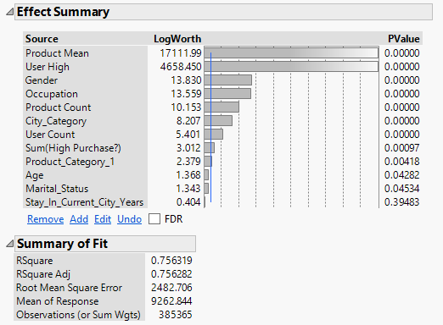

Linear Regression Model 2
Result of Liner Regression Model with new variables

Slide 12
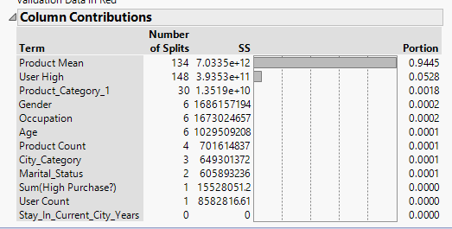
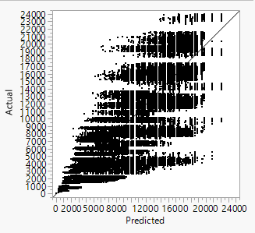
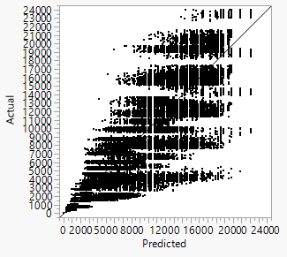



Regression Tree and Ensemble Techniques
Training and Validation - Actual v/s Predicted
Bootstrap Forest
Result of Regression Tree Model
Boosted Tree

Slide 13
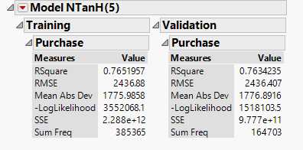
Neural Network
Result of Neural Network Model

Slide 14
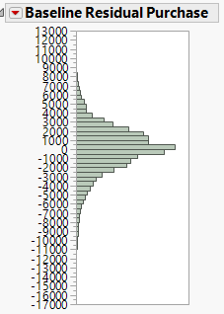
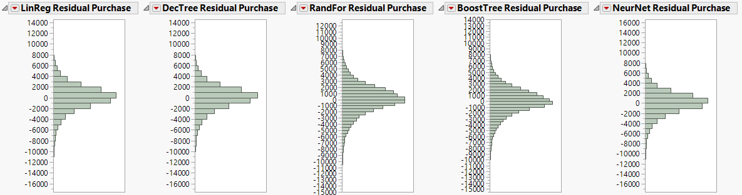
Model Comparison and Validation
Residual Distribution
Comparison of Relative Errors
Correlation of Actual Price and Predicted Price by different models for a product

Slide 15



Case Reviews
Gender | M
Age | 18-25
Occupation | 4
City Category | C
Stay in City in years | 1
Marital Status | 0
User High Purhase Proportion | 0.736842
Predicted Price | 12067.73
Gender | F
Age | 18-25
Occupation | 4
City Category | C
Stay in City in years | 1
Marital Status | 0
User High Purhase Proportion | 0.6
Predicted Price | 11705.81
Gender | F
Age | 18-25
Occupation | 4
City Category | C
Stay in City in years | 2
Marital Status | 0
User High Purhase Proportion | 0.714286
Predicted Price | 12390.67

Slide 16




Case Reviews
Gender | M
Age | 26-35
Occupation | 4
City Category | C
Stay in City in years | 0
Marital Status | 1
User High Purhase Proportion | 0.5
Predicted Price | 10377.86
Gender | F
Age | 18-25
Occupation | 20
City Category | C
Stay in City in years | 4+
Marital Status | 0
User High Purhase Proportion | 0.509434
Predicted Price | 10782.93
Gender | M
Age | 55+
Occupation | 6
City Category | C
Stay in City in years | 1
Marital Status | 1
User High Purhase Proportion | 0.509434
Predicted Price | 10814.23
Gender | F
Age | 26-35
Occupation | 9
City Category | B
Stay in City in years | 1
Marital Status | 0
User High Purhase Proportion | 0.5
Predicted Price | 11139.47

Slide 17
Future Upgrades: Market Basket Analysis
Association Rule for: P00265242, P00025442, P00110742 P00112142
Type | Values
P00265242 | 1880
P00025442 | 1615
P00110742 | 1612
P00112142 | 1562
(P00265242 & P00025442 & P00110742) | 248
(P00265242 & P00025442 & P00110742) & P00112142 | 112
Support | 112/5891 = 0.019
Confidence | 112/248 = 0.45
Expected | 1562/5891 = 0.26
Lift Ratio | 0.45/0.26 = 1.73
By identifying the association rule between the products, we can create a recommender system for customer which would recommend customers the products they can buy based on the products already placed in their shopping cart. In addition to this, we can plan to create a model that would provide a better personalized offer for combo deals and bulk buying.

Slide 18
Questions?

